Slide 1

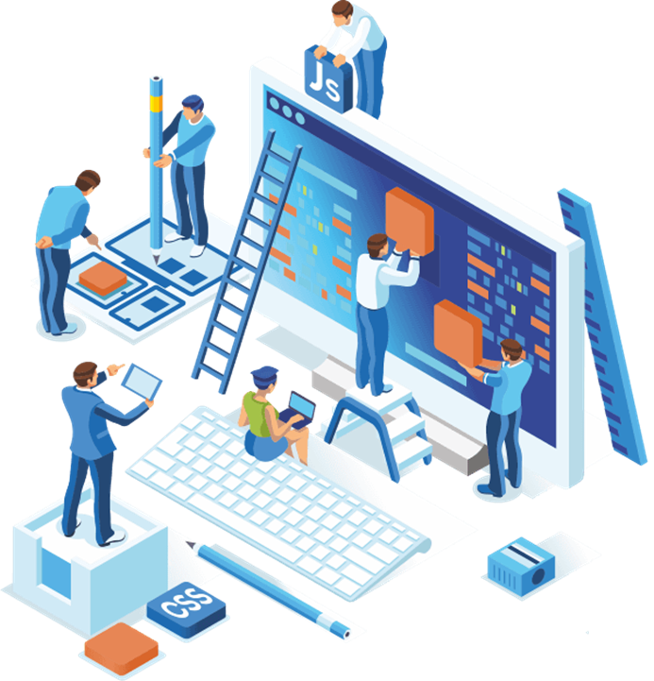
Secure Software Development
Portfolio №1
University of Roehampton, Cyber Security
Group №5:
Alex
Jakh (ALI21547686)
Dmitriy
Asad

Slide 2

USE CASE №1
Company Name: Pitrix
Company Specialisation: A leading developer and manufacturer of advanced vehicle tracking and navigation systems for professional motor racing teams.
Cyber risk appetite: High Risk
System architecture: Data Center, Vehicle Tracking Devices, Mobile App
Data Types: Vehicle Performance Data, Navigation Data, Weather Data, Driver Feedback, Personal Data

Slide 3
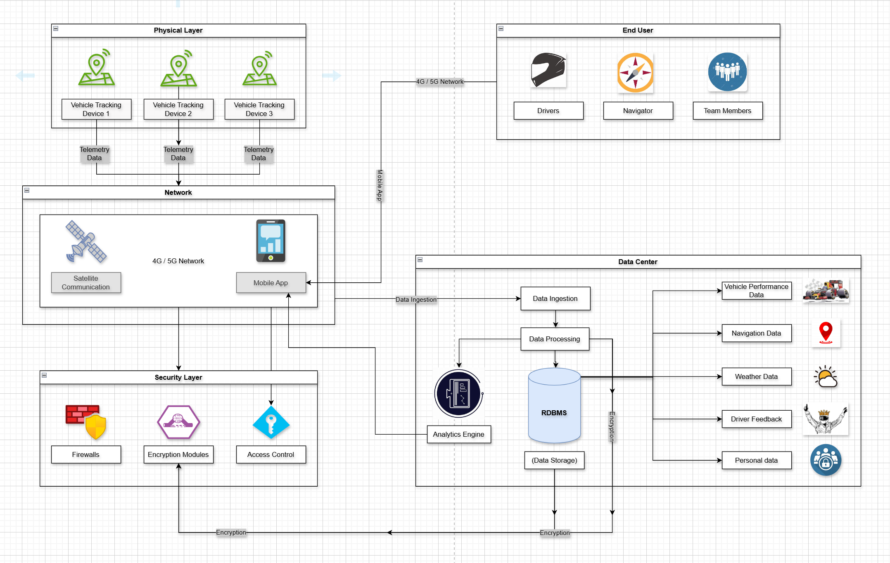
PRODUCT ARCHITECTURE FOR NAVTRACK (PITRIX) PROJECT

Slide 4
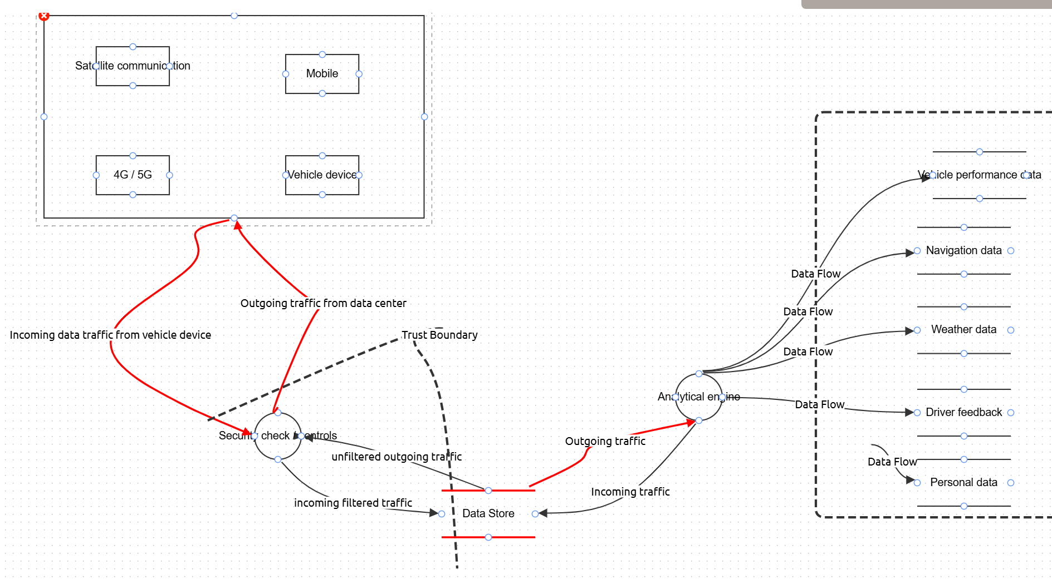
THREAT MODEL FOR NAVTRACK (PITRIX) PROJECT

Slide 5
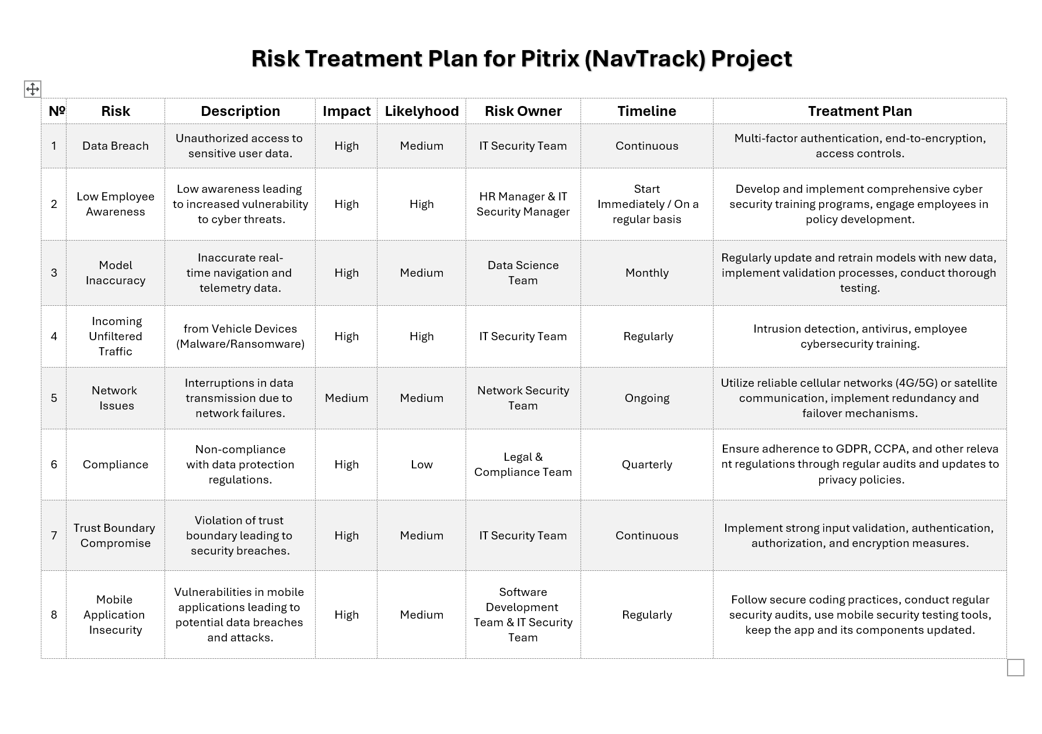
This risk treatment plan outlines strategies to mitigate the key vulnerabilities identified in Pitrix's threat model. Recognizing Pitrix's high cyber risk appetite and its current security posture, the plan balances risk reduction with operational efficiency.

Slide 6

SOFTWARE DEVELOPMENT PLAN
Introduction and Scope
Pitrix is a company which is going to be the manufacturer of advanced vehicle tracking and navigation systems for professional motor racing teams. The company aims to optimize vehicle performance, reduce lap times, and enhance overall racing experience through the creation of a mobile application which will provide real-time navigation data, vehicle telemetry and analytics. The end goal is to allow professional motor racing teams to gain a competitive edge to increase their chances of winning.
2. Objective:
To develop a secure software solution that provides accurate navigation and telemetry data for vehicle tracking, while minimizing cyber risks.

Slide 7

SOFTWARE DEVELOPMENT PLAN
3. Roles and Responsibilities
IT Security Team: Responsible for implementing cybersecurity controls, including multi-factor authentication, encryption, intrusion detection, and security training.
HR Manager: Hiring new employees, managing employee relations, handling training and development, and ensuring workplace policies are followed.
Data Science Team: a group of professionals who use data analysis, machine learning, and statistical methods to extract insights and make data-driven decisions.
Network Security Team: Manages network infrastructure and its security, redundancy, and failover mechanisms.
Legal & Compliance Team: Ensures the software adheres to relevant data protection regulations (e.g., GDPR, CCPA).
Software Development Team: Develops secure code, updates mobile applications, and collaborates with the IT Security Team on vulnerability management.

Slide 8
SOFTWARE DEVELOPMENT PLAN
4. Requirements and Specifications
Functional Requirements:
Implement secure user authentication (multi-factor).
Enable real-time tracking with high data accuracy.
Provide mobile access with secure communication protocols.
Non-Functional Requirements:
Ensure high availability and reliability of network connections.
Comply with privacy regulations and policies.
Technical Requirements:
Use end-to-end encryption for data transmission.
Enable secure coding practices for mobile applications.

Slide 9
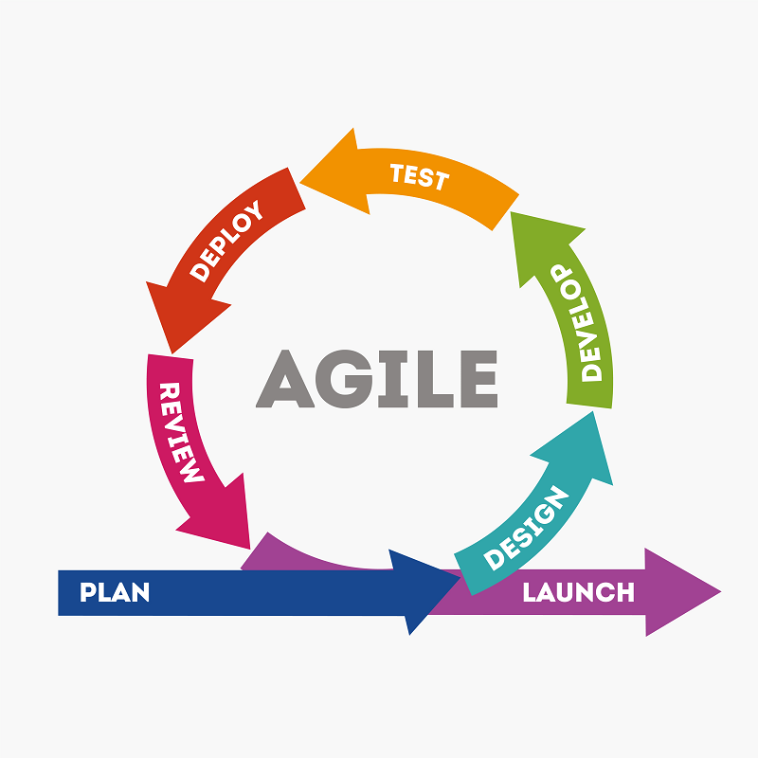
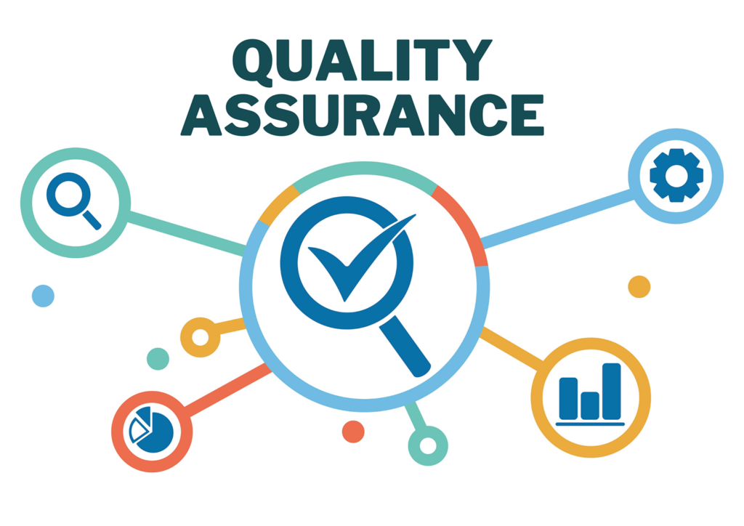
SOFTWARE DEVELOPMENT PLAN
5. Development Methodology
Agile Methodology:
Due to the project’s need for continuous updates and frequent security enhancements, Agile is chosen as the development methodology. Sprint reviews will be conducted to ensure timely responses to security requirements and risk management actions.
6. Quality Assurance (QA) and Testing
Testing Approach:
Security testing to detect vulnerabilities in mobile apps and data transmission.
Model validation tests to ensure data accuracy.
Regular penetration testing and security audits.
KPIs:
Number of security incidents detected and mitigated.
Compliance rate with data protection regulations.
Model accuracy rate for real-time navigation data.

Slide 10

SOFTWARE DEVELOPMENT PLAN
7. Deployment and Release Plan
Deployment Strategy: Cloud deployment with high availability and redundancy.
Release Management: Version control for phased releases, ensuring each version is tested for security and compliance.
Rollback Plan: Establish a rollback strategy to revert to a previous stable version if issues arise.
8. Maintenance and Support Plan
Ongoing Security Updates: Regular patches for security vulnerabilities, especially for mobile applications.
Employee Training: Periodic refresher training on cybersecurity for relevant team members.
Compliance Checks: Quarterly audits and regular updates to privacy policies as laws evolve.

Slide 11
SOFTWARE DEVELOPMENT PLAN
9. Tools for securing software development
OWASP ZAP and Burp Suite - Essential for penetration testing of the mobile app and web interfaces, identifying vulnerabilities that could impact real-time data accessibility.
Snyk - Scans open-source dependencies for known vulnerabilities, ensuring secure third-party libraries in the application.
SonarQube - Analyses code quality and detects security vulnerabilities in the mobile app and backend.
ELK Stack (Elasticsearch, Logstash, Kibana) - Manages logs and helps identify suspicious activity in telemetry data, navigation data, and personal information access.
Prometheus and Grafana - Monitors system health, performance metrics, and real-time data transmission to ensure uninterrupted service during races.
Tenable Nessus - Vulnerability scanner for network and system security, particularly useful for securing the data center and communication networks.
Cloudflare or Akamai WAF - Protects against DDoS attacks and malicious traffic that could disrupt data transmission and telemetry analysis.
Aqua Security and Docker Bench for Security - Ensures security of any containerized components, such as the Data Center’s data processing units.

Slide 12

USE CASE №2
Company Name: LuminaX
Company Specialisation: A cutting-edge start-up that specializes in developing innovative generative AI solutions.
Cyber risk appetite: Very Low (LuminaX prioritizes minimizing potential risks over potential rewards).
System architecture: Frontend, Backend, AI Engine, Database, Network Connectivity.
Data Types: User-generated content, AI model parameters, System logs, Personal Data.

Slide 13
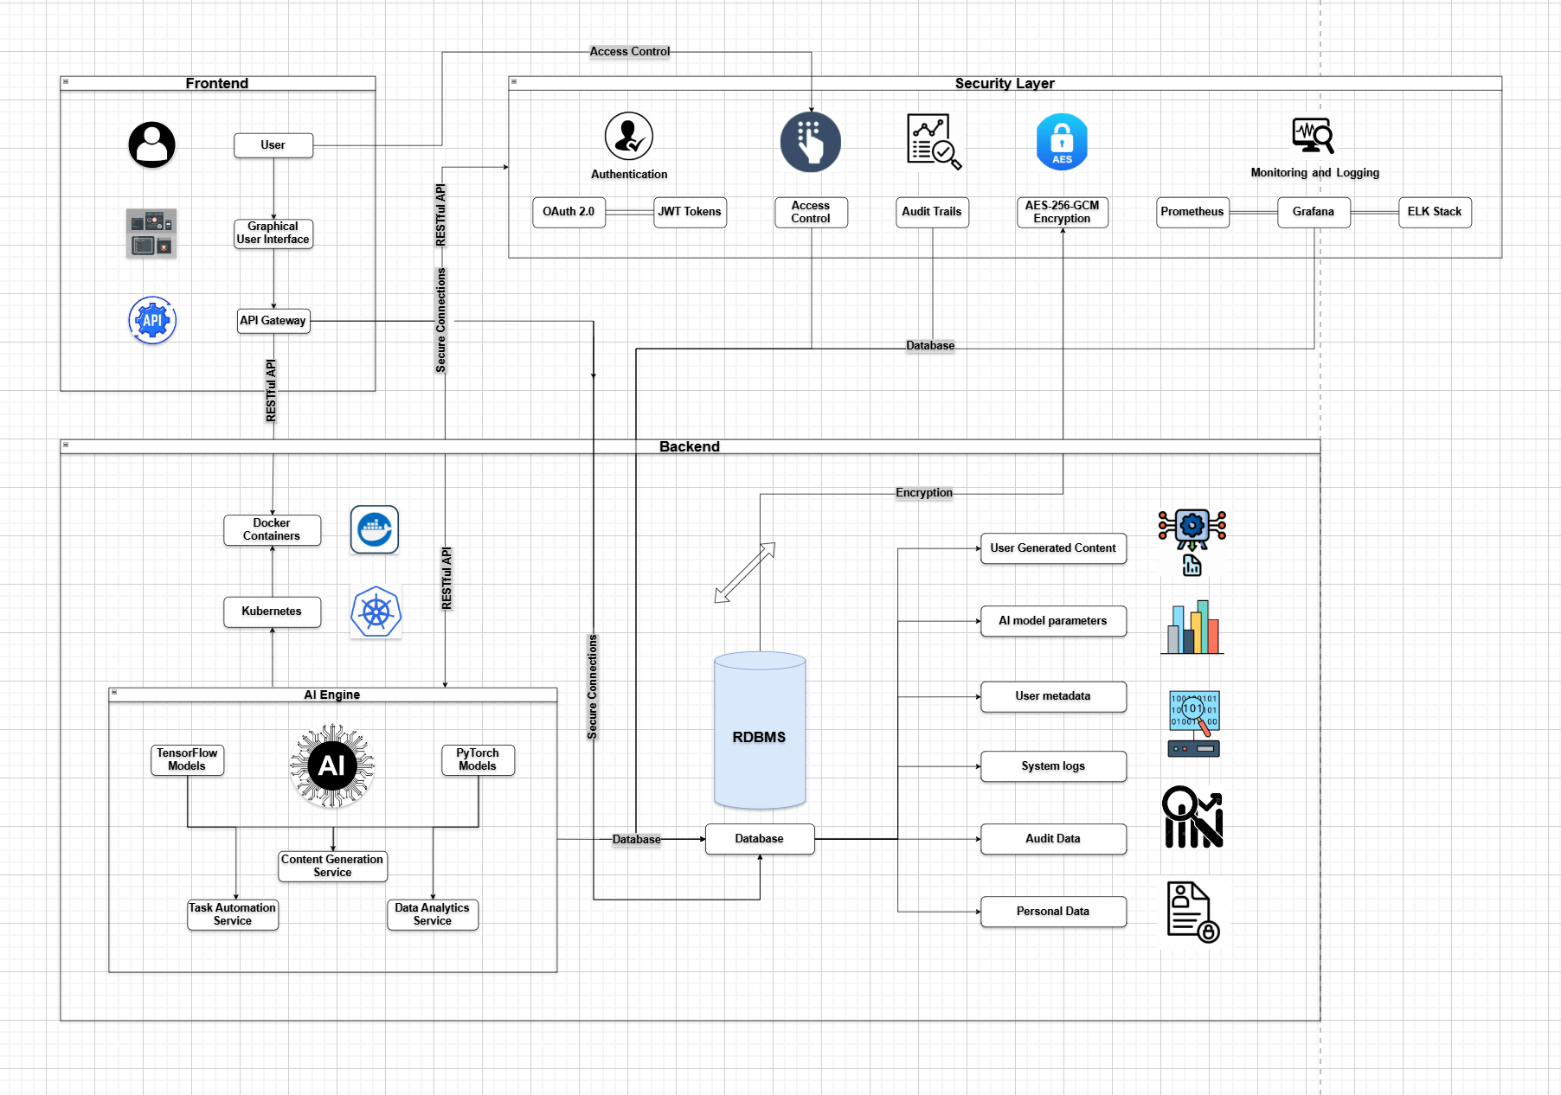
PRODUCT ARCHITECTURE FOR LUMINAX PROJECT

Slide 14
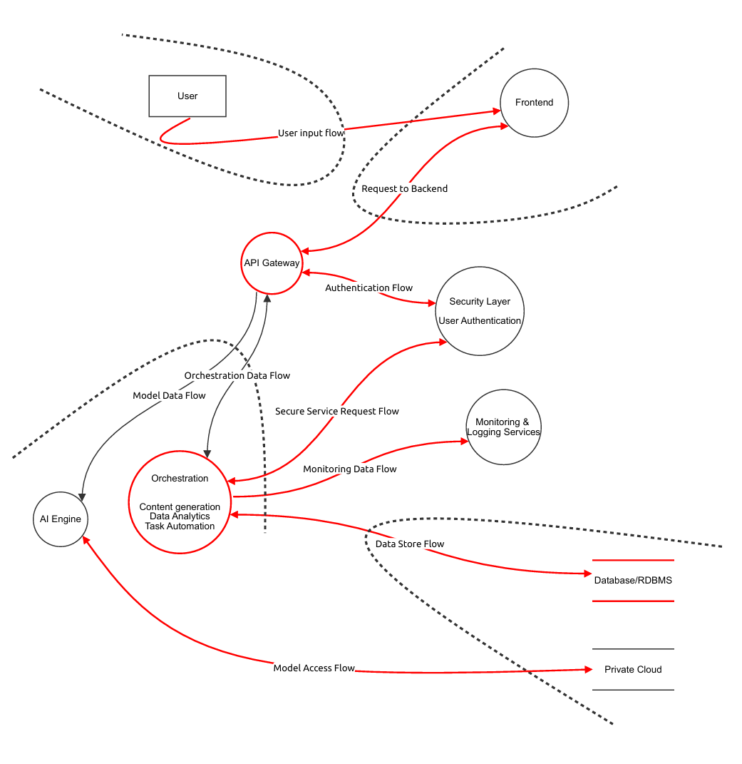
THREAT MODEL FOR LUMINAX PROJECT

Slide 15
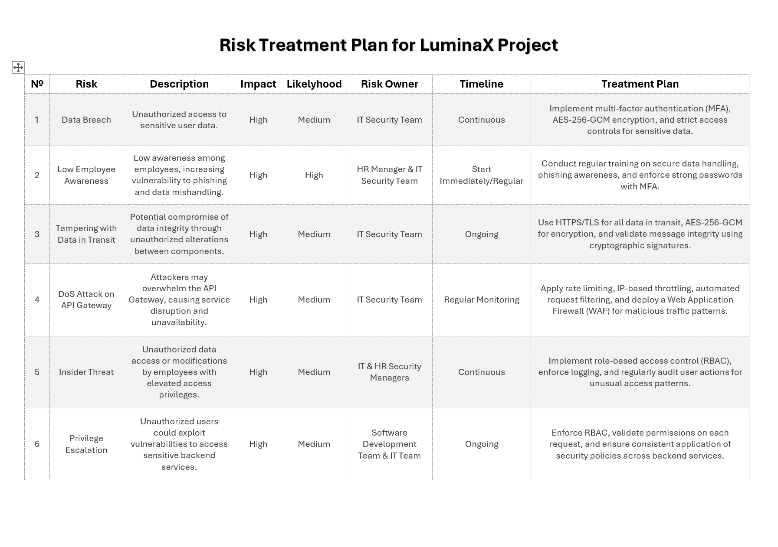
This plan is designed to help LuminaX effectively mitigate security risks and uphold its "very low" cyber risk appetite while enabling safe and reliable operations for the LumiMind platform.

Slide 16
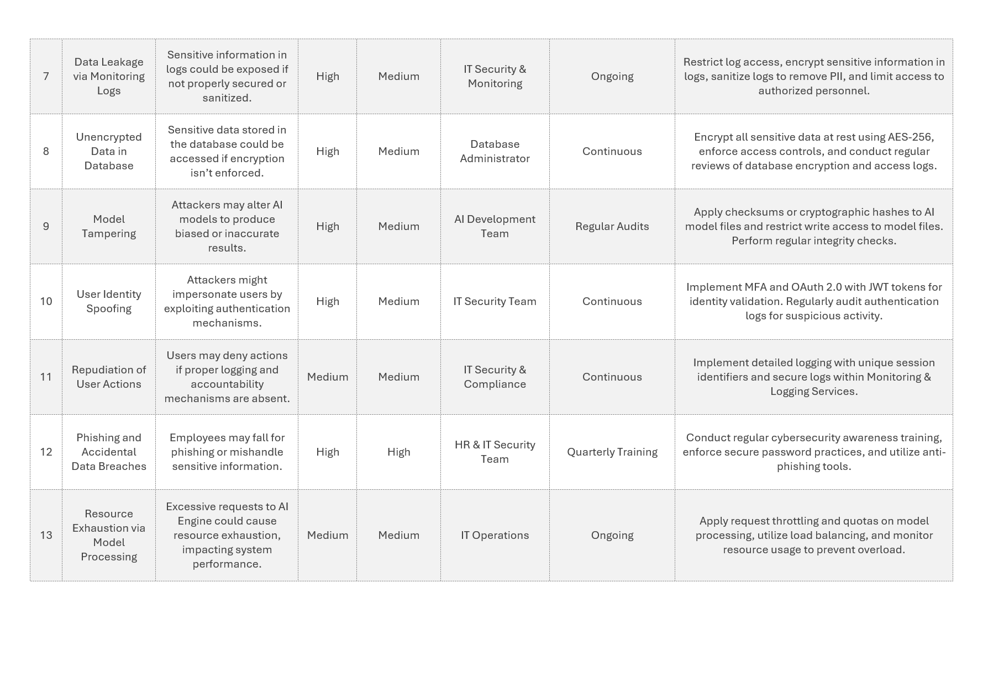

Slide 17
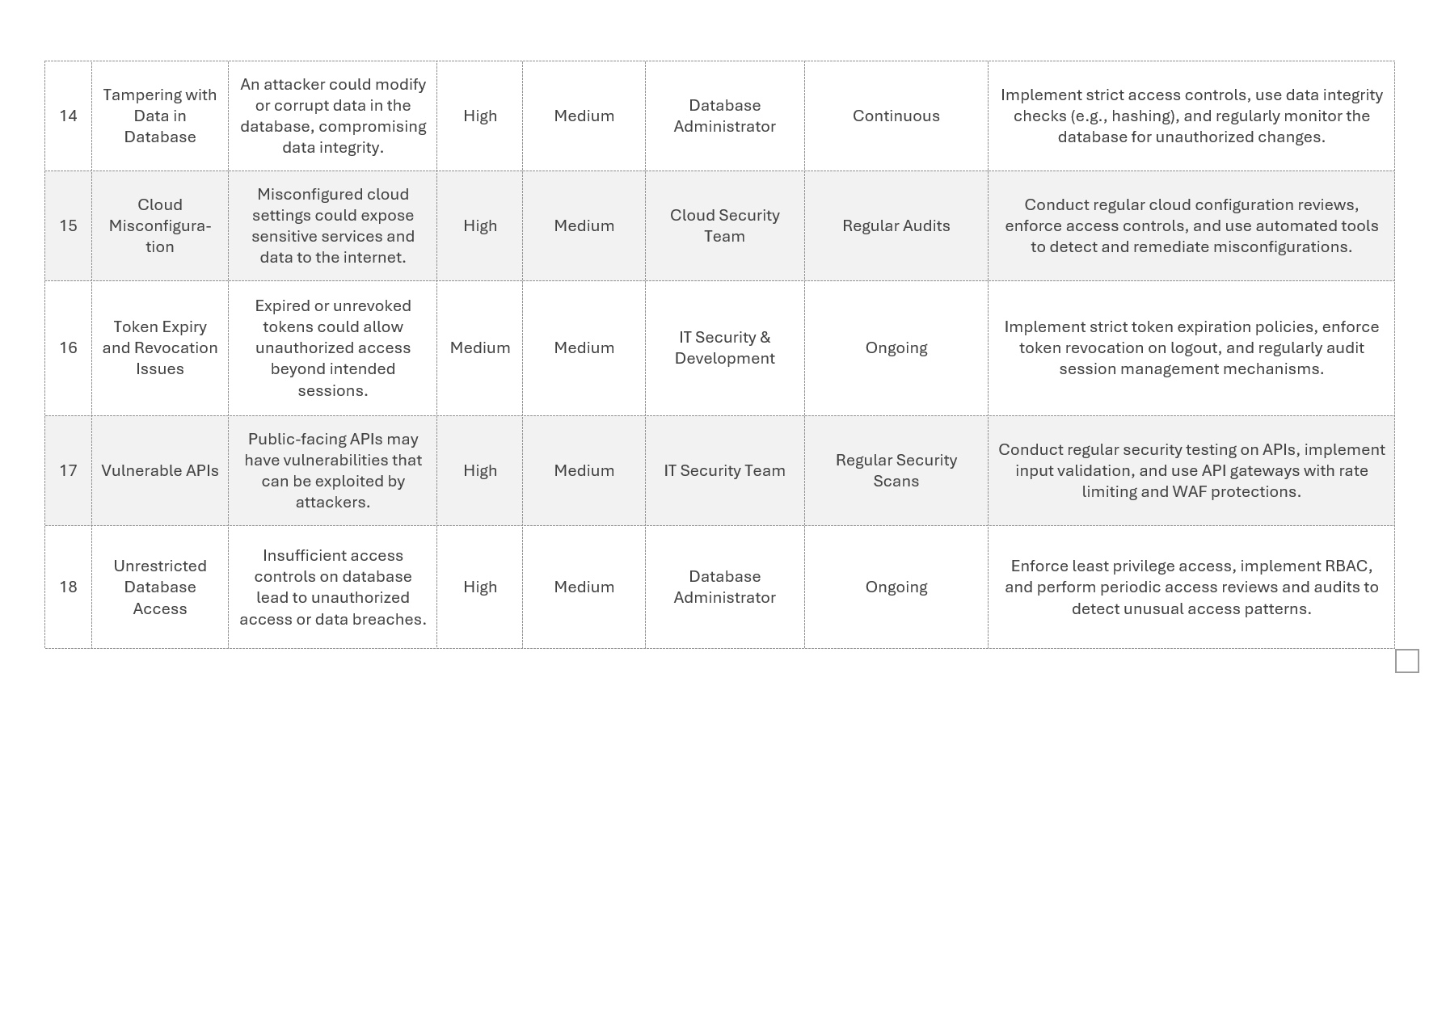

Slide 18

SOFTWARE DEVELOPMENT PLAN
Introduction and Scope
This Software Development Plan describes the approach for building a secure and reliable software solution for LuminaX’s LumiMind product. LumiMind is designed to help users with content creation, analytics, and automation, making their work easier and more efficient. Because LuminaX has a very low tolerance for cybersecurity risks, this plan focuses heavily on security throughout the software development process. The aim is to protect against issues like unauthorized access, data breaches, and service disruptions. By keeping security at the forefront of development, LuminaX intends to deliver a product that meets high standards for both reliability and compliance with data protection regulations.
2. Objective:
To deliver a secure, AI-powered product for content generation, analytics, and automation, providing a seamless and secure experience.

Slide 19

SOFTWARE DEVELOPMENT PLAN
3. Roles and Responsibilities
IT Security Team: Ensures secure authentication, access controls, and ongoing threat monitoring.
HR Manager: Conducts cybersecurity training to increase employee awareness and prevent phishing and data mishandling.
Database Administrator: Implements encryption, access controls, and database monitoring.
Software Development Team: Integrates security controls (RBAC, MFA) into the backend and frontend and performs code reviews.
Cloud Security Team: Manages secure cloud configurations and reviews for potential misconfigurations.
Network Security Team: Manages network infrastructure and its security, redundancy, and failover mechanisms.
Legal & Compliance Team: Ensures the software adheres to relevant data protection regulations (e.g., GDPR, CCPA).

Slide 20
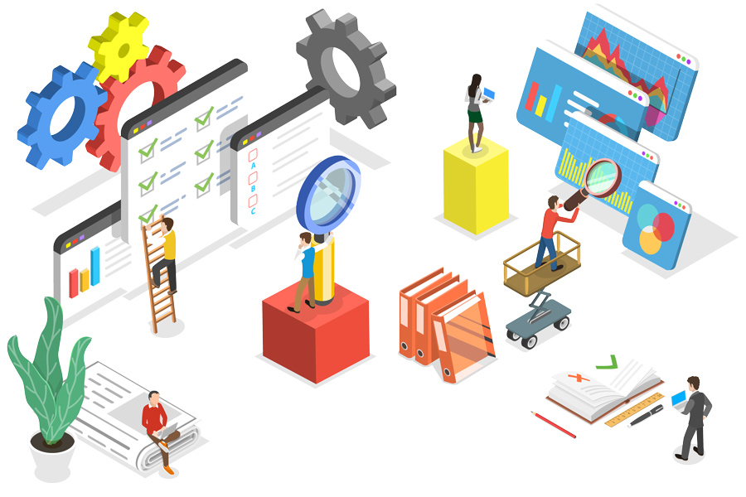
SOFTWARE DEVELOPMENT PLAN
4. Requirements and Specifications
Functional Requirements:
Multi-factor authentication (MFA) and OAuth 2.0 with JWT for secure login.
Role-based access control (RBAC) across all user roles and data.
Automated content generation, data processing, and analytics capabilities.
Non-Functional Requirements:
AES-256 encryption for data at rest and HTTPS/TLS for data in transit.
Compliance with data protection regulations (GDPR, CCPA).
Technical Requirements:
Microservices architecture with Docker and Kubernetes for scalability.
Secure APIs with input validation, rate limiting, and Web Application Firewall (WAF).
Real-time monitoring and logging with Prometheus, Grafana, and ELK Stack.

Slide 21

SOFTWARE DEVELOPMENT PLAN
5. Development Methodology
Agile Methodology: Adopted to allow iterative development, enabling the team to integrate security improvements based on testing feedback continuously.
Sprints: Security reviews at the end of each sprint to ensure the integration of security practices in each component before moving forward.
6. Quality Assurance (QA) and Testing
Security Testing:
Regular penetration testing on APIs, data flows, and storage
to identify potential vulnerabilities.
Use automated tools for continuous scanning of security
and compliance.
API Security Testing:
Validate input and set up rate limiting, ensuring all external
interfaces are secure.
Performance Testing:
Simulate high request volumes to ensure
resilience against DoS attacks, especially on the
API Gateway and AI Engine.
Code Reviews and Audits:
Regular code reviews focusing on secure coding
practices.
Audit logs for unusual activity or security
breaches.

Slide 22

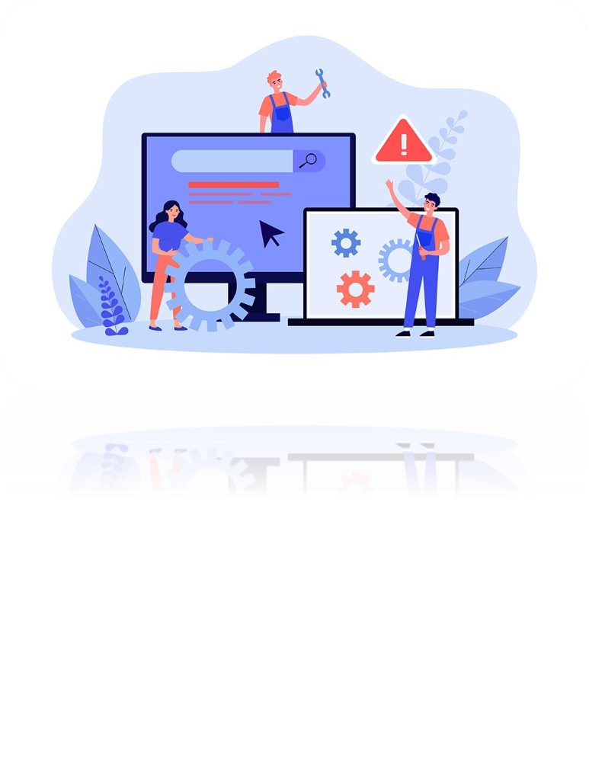
SOFTWARE DEVELOPMENT PLAN
7. Resource and Staffing Plan
Security Tools: Tools for encryption (AES-256), token management (OAuth 2.0, JWT), and secure API testing.
Database and Logging Tools: RDBMS with encrypted storage, audit log capabilities, and the ELK Stack for log analysis.
Training Resources: Materials for regular cybersecurity training, phishing simulations, and secure data handling.
8. Maintenance and Support Plan
Continuous Monitoring: Use Prometheus, Grafana, and ELK Stack to monitor the system for potential threats.
Scheduled Audits and Reviews: Conduct quarterly security audits and compliance reviews.
Employee Training: Regular cybersecurity training, focusing on updates in phishing methods, secure data handling, and password policies.
Compliance Tracking: Ensure continuous alignment with GDPR, CCPA, and any emerging data protection regulations.

Slide 23

SOFTWARE DEVELOPMENT PLAN
9. Tools for securing software development
SonarQube for code quality and security analysis.
OWASP ZAP and Burp Suite for web application security testing.
Snyk and Checkmarx for dependency and code vulnerability scanning.
HashiCorp Vault for secrets management.
Aqua Security and Docker Bench for Security for container security.
Prometheus and Grafana for monitoring and logging.
ELK Stack for log management and analysis.

Slide 24



Thank You for your attention!
Group №5: Alex, Jakh, Dmitriy, Asad

